Slide 1
New Features SQL Server 2019 John Deardurff

Slide 2



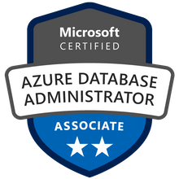



John Deardurff
Customer Engineer (Global Technical Team)
Microsoft Certified Trainer (Regional Lead)
MVP: Data Platform (2016 – 2018)
Twitter: @SQLMCT
Website: www.SQLMCT.com

Slide 3
Before we begin…
This is a one-hour session covering material from a three-day course.
We will not be going in-depth into any single topic but providing an overview of the new features of SQL Server 2019.
If you would like to go more in-depth, we can provide a session on each specific topic.

Slide 4
What does this session cover?
New Features of SQL Server 2016/2017/2019
TempDB Improvements
Accelerated Database Recovery
Intelligent Query Processing
Polybase and Big Data Clusters

Slide 5
Get started with SQL Server 2019
Download and try it: http://aka.ms/ss19
Use our free training: https://aka.ms/sqlworkshops
Use examples through our https://aka.ms/SQL2019Notebooks
Learn from videos: https://aka.ms/sql2019learning
Read what’s new for SQL 2019: documentation
Watch how to Modernize SQL Server: check out the video
One shortcut to rule them all: https://aka.ms/SQLShortcuts
Get the book: https://aka.ms/sql2019book

Slide 6
Lesson 1 New SQL Server Features Overview

Slide 7

New Features of SQL Server 2016
Always Encrypted
Dynamic Data Masking
Temporal Tables
Row-Level Security
JSON Support
Support for R
Multiple TempDB Database Files
Trace Flags 1117 & 1118 enabled
Polybase
Query Store
Stretch Database
Live Query Statistics
https://docs.microsoft.com/en-us/sql/sql-server/what-s-new-in-sql-server-2016
Notes:
Please consider editing or deleting “Give me the top queries that have changed in performance compared to the number of executions. “

Slide 8


New Features of SQL Server 2017
Automatic Database Tuning
Adaptive Query Processing
Batch mode adaptive joins
Interleaved execution
Batch mode memory grant feedback
Resumable Online Index Rebuild
Graph Database Capabilities
Support for Python
SQL Server on Linux
Clusterless Availability Groups
Cross-OS Availability Groups
Database Scoped Configuration
Turn Identity_Cache On/OFF
https://docs.microsoft.com/en-us/sql/sql-server/what-s-new-in-sql-server-2017
Notes:
Please consider editing or deleting “Give me the top queries that have changed in performance compared to the number of executions. “

Slide 9
New Features of SQL Server 2019
Accelerated Database Recovery
Always Encrypted / Secure Enclaves
Big Data Clusters
Intelligent Query Processing
Table Variable deferred compilation
Batch mode on Rowstore indexes
Scalar User Defined Function in-lining
Approximate Query Processing
TempDB improvements
Data Discovery and Classification
Optimize for sequential key
https://docs.microsoft.com/en-us/sql/sql-server/what-s-new-in-sql-server-2019
Notes:
Please consider editing or deleting “Give me the top queries that have changed in performance compared to the number of executions. “

Slide 10
Lesson 2 Accelerated Database Recovery

Slide 11
Accelerated Database Recovery
Accelerated Database Recovery is a new SQL Server Engine feature that greatly improves database availability by completely redesigning the current SQL Server recovery process.
Instantaneous Transaction Rollback
Aggressive Log Truncation
Benefits of Accelerated Database Recovery
Fast & Consistent Database Recovery

Slide 12
Current Database Recovery Process
Phase 1: Analysis
Determines the state of each transaction in the system at the time SQL Server stopped.
Phase 2: Redo
Returns the database to the state it was in at the time the SQL Server stopped.
[DB is PARTIALLY available after Redo]
Phase 3: Undo
Rolls back any uncommitted transaction(s) individually.
[DB is FULLY available after Undo]
Log
Start
Oldest
uncommitted Tx
(XACT_BEGIN_LSN)
Checkpoint
(or oldest dirty page LSN)
Log
End
Notes:
Analysis phase
Forward scan of the transaction log from the beginning of the last successful checkpoint (or the oldest dirty page LSN) until the end, to determine the state of each transaction at the time SQL Server stopped.
Redo phase
Forward scan of the transaction log from the oldest uncommitted transaction until the end, to bring the database to the state it was at the time of the crash by redoing all committed operations.
Undo phase
For each transaction that was active as of the time of the crash, traverses the log backwards, undoing the operations that this transaction performed.
https://docs.microsoft.com/en-us/azure/sql-database/sql-database-accelerated-database-recovery

Slide 13
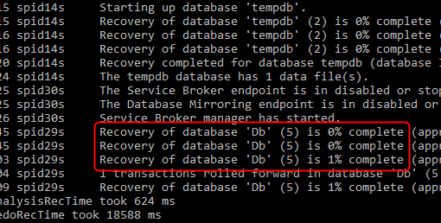
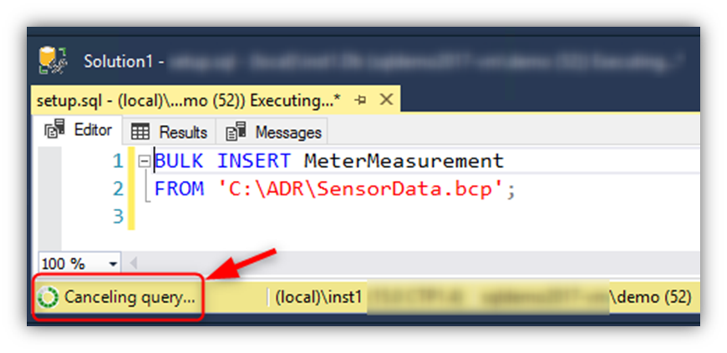
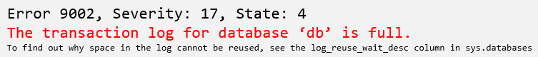
Most common implications
Recovery time is roughly proportional to the longest running transaction.
Rolling back large batch operations (e.g. bulk insert) takes a long time.
Transaction log may run out of space during long-running transactions.

Slide 14
Accelerated Database Recovery process
Phase 1: Analysis
Regular Analysis + Reconstructs sLog
Phase 2b: Redo
Phase 2a: Redo from sLog
Phase 2b: Redo from Transaction Log (starts from last checkpoint)
Phase 2a: Redo from sLog
[DB is FULLY available and all locks
are released after Redo]
Phase 3: Undo from sLog
Instant Undo by using sLog and Persisted Version Store (PVS) with Logical Revert.
sLog Records
Transaction Log
sLog (in memory)
Log
Start
Oldest
uncommitted Tx
(XACT_BEGIN_LSN)
Checkpoint
(or oldest dirty page LSN)
Log
End
Log Record for non-versioned operation
Notes:
Analysis phase
The process remains the same as today with the addition of reconstructing sLog and copying log records for non-versioned operations.
Redo phase
Broken into two phases (P)
Phase 1
Redo from sLog (oldest uncommitted transaction up to last checkpoint). Redo is a fast operation as it only needs to process a few records from the sLog.
Phase 2
Redo from Transaction Log starts from last checkpoint (instead of oldest uncommitted transaction)
Undo phase
The Undo phase with ADR completes almost instantaneously by using sLog to undo non-versioned operations and Persisted Version Store (PVS) with Logical Revert to perform row level version-based Undo.
https://docs.microsoft.com/en-us/azure/sql-database/sql-database-accelerated-database-recovery

Slide 15
Accelerated Database Recovery Components
Persisted Version Store
The version can be stored in-row or off-row within the database, it will vary according to the row size;
Versions have the previous state of the data and the Transact-ID of the version;
Fast UNDO, instead of rollback the active transactions (traditional recovery process) they are just marked as ABORTED.
Persists row versions in the database itself rather than TempDB.
PVS
Persisted Version Store
Logical Revert
sLog
Special
In-Memory Log Stream
Cleaner

Slide 16
Accelerated Database Recovery Components
Logical Revert
Asynchronous process that performs row-level version-based Undo;
Keeps track of all aborted transactions;
Performs rollback using PVS for all user transactions;
Release all locks immediately after transaction abort.
PVS
Persisted Version Store
Logical Revert
sLog
Special
In-Memory Log Stream
Cleaner

Slide 17
Accelerated Database Recovery Components
sLog
Secondary in-memory log stream that stores log records for non-versioned operations (e.g.: metadata cache invalidation, lock acquisitions);
Persisted on disk by been serialized during SQL checkpoint;
Is periodically truncated as transactions commits;
It accelerates the redo and undo by processing only the non-versioned operations;
PVS
Persisted Version Store
Logical Revert
sLog
Special
In-Memory Log Stream
Cleaner

Slide 18
Accelerated Database Recovery Components
Cleaner
Asynchronous process that periodically cleans row versions that are not needed.
PVS
Persisted Version Store
Logical Revert
sLog
Special
In-Memory Log Stream
Cleaner

Slide 19
How to enable ADR?
Azure SQL Database
It’s ON by default.
SQL Server 2019
ALTER DATABASE <db_name> SET ACCELERATED_DATABASE_RECOVERY = ON
(PERSISTENT_VERSION_STORE_FILEGROUP = [VersionStoreFG])
Notes:
https://docs.microsoft.com/en-us/sql/relational-databases/accelerated-database-recovery-management?view=sql-server-ver15

Slide 20
Accelerated Dabase Recovery FAQ
Will my database be larger?
Yes. Monitor to determine difference.
Will it affect performance?
It depends. Write-heavy (OLTP) workloads are most susceptible
How is PVS different than the version store in TempDB?
PVS stores versions in the user database rather than TempDB
If ADR is enabled, PVS is used to support SNAPSHOT and READ_COMMITTED_SNAPSHOT_ISOLATION transactions
How does this affect Availability Groups?
PVS and log records replicate to secondaries, secondary communicates oldest versions needed to primary
ADR can speed up failover because Undo becomes fast
If the secondary must be restarted without ADR, TempDB is lost so versions are lost and queries must wait for data to commit on primary, with ADR, versions are persisted, so no delay before queries can be served

Slide 21
Lesson 3 Polybase and Big Data Clusters Overview

Slide 22
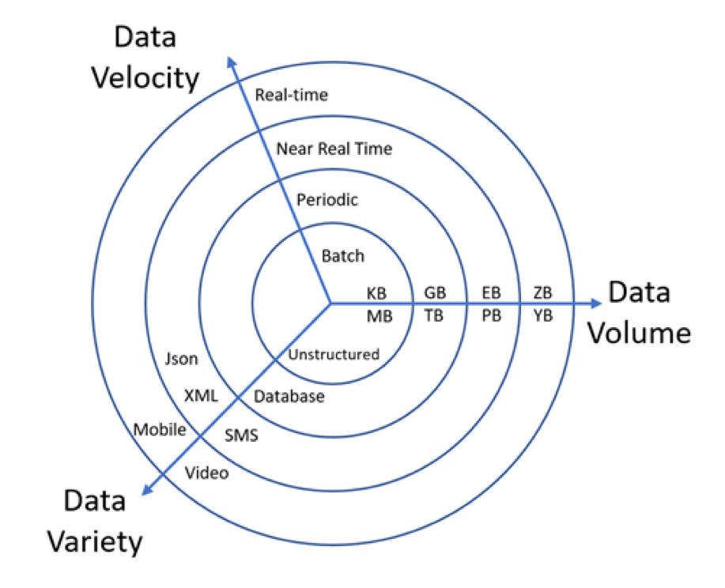
Concepts of Big Data
Volume: Quantity of generated and stored data
Variety: The type and nature of data
Velocity: Speed at the data is generated and processed.
Notes:
Parameter-sensitive? GLOBAL query
GLOBAL: Do not capitalize generic terms. Please note that we do not capitalize terms unless they are from the UI or are feature or product names. Please consider lowercasing such terms throughout this document.
GLOBAL: Please avoid using first person (“we”, “I”) Always use “you” or “Microsoft” if that is applicable.
…have a lot of …?

Slide 23









Polybase in SQL Server 2019
Distributed compute engine integrated with SQL Server
Query data where it lives using T-SQL
Distributed, scalable query performance
Manual/deploy with SQL Server
Auto deploy/optimize with Big Data Clusters
Analytics
T-SQL
Apps
SQL Server
PolyBase external tables
Scale out compute for performance
ODBC (Windows Only)
NoSQL
Relational databases
Big data
Excel
SQL Server
SQL Database
SQL Data Warehouse
Azure Cosmos DB
Azure Blob Storage
(SQL Server 2016+)
Notes:
Parameter-sensitive? GLOBAL query
GLOBAL: Do not capitalize generic terms. Please note that we do not capitalize terms unless they are from the UI or are feature or product names. Please consider lowercasing such terms throughout this document.
GLOBAL: Please avoid using first person (“we”, “I”) Always use “you” or “Microsoft” if that is applicable.
…have a lot of …?

Slide 24
SQL Server 2019 Big Data Clusters and Polybase
The Problem
Customers want to integrate with Big Data and other data sources easily
Polybase is not simple to setup, configure, maintain, and scale elastically
Customers may not have a Hadoop cluster or want to build one
Polybase “classic” (MapReduce) could be better
Kubernetes and containers to deploy and scale elastically
Everything pre-installed including HDFS cluster
Build a control plane to help manage and monitor
Enhance SQL Server to read from HDFS natively
Provide a data mart for cached results
Introduce Spark and Notebooks for Data scientists
The Solution

Slide 25
SQL Server 2019 Big Data Cluster Scenarios
Data virtualization
Managed SQL Server, Spark, and data lake
Complete AI platform
Admin portal and management services
Integrated AD-based security
Analytics
T-SQL
Apps
REST API containers for models
SQL Server External Tables
SQL Server
Spark
SQL Server
ML Services
Spark & Spark ML
Compute pools and data pools
Scalable, shared storage (HDFS)
Open database connectivity
NoSQL
Relational databases
HDFS
External data sources
HDFS
Store high volume data in a data lake and access it easily using either SQL or Spark
Management services, admin portal, and integrated security make it all easy to manage
Easily feed integrated data from many sources to your model training
Ingest and prep data and then train, store, and operationalize your models all in one system
Combine data from many sources without moving or replicating it
Scale out compute and caching to boost performance
Notes:
Amit starts here

Slide 26

















SQL Server 2019 Big Data Clusters
The combination of SQL Server, Polybase, HDFS, Spark, and Machine Learning in one solution
Custom apps
BI
Analytics
Controller
SQL Server master instance
Availability Group
Active Directory
Kubernetes
PolyBase
Scale performance with compute pool
Languages
App Deploy
Any external data source
SQL Compute Node
SQL Compute Node
…
SQL Compute Node
PolyBase
Data lakes with storage pool
SQL Server
SQL Server
…
SQL Server
Scale out data mart with Data pool
HDFS
HDFS
HDFS
HDFS
HDFS
HDFS
HDFS tiering
Intelligence over any data
Notes:
Whole quote:
"Building and deploying our vertical AI-solution for clinical radiology combines very diverse implementation paradigms, data formats and regulatory requirements. SQL Server 2019 big data clusters allowed us to accommodate and integrate all aspects from one shared platform - for our data scientists with their deep learning as well as for our software engineers who wire up workflows, security and scalability. At runtime, our healthcare customers benefit from simple containerized deployment and maintenance while being able to move our solution between on-prem and the cloud easily."
René Balzano, Founder and CEO, Balzano

Slide 27
Lesson 4 Intelligent Query Processing

Slide 28
Intelligent Query Processing
Interleaved Execution
Memory Grant Feedback
Adaptive Joins
Intelligent Query Processing
Adaptive Query Processing
Batch Mode
Row Mode
Table Variable Deferred Compilation
Batch Mode On Rowstore Indexes
Scalar UDF Inlining
Approximate Query Processing
Approximate Count Distinct
Azure SQL Database
http://aka.ms/IQP
SQL Server 2017
SQL Server 2019
Notes:
Parameter-sensitive? GLOBAL query
GLOBAL: Do not capitalize generic terms. Please note that we do not capitalize terms unless they are from the UI or are feature or product names. Please consider lowercasing such terms throughout this document.
GLOBAL: Please avoid using first person (“we”, “I”) Always use “you” or “Microsoft” if that is applicable.
…have a lot of …?

Slide 29
Adaptive Query Processing (2017)
Interleaved Execution
Memory Grant Feedback
Adaptive Joins
Adaptive Query Processing
Batch Mode
Addresses performance issues related to the cardinality estimation of an execution plan.
These options can provide improved join type selection, row-calculations for Multi-Statement Table-Valued Functions, and memory allocation of row storage.
Notes:
Parameter-sensitive? GLOBAL query
GLOBAL: Do not capitalize generic terms. Please note that we do not capitalize terms unless they are from the UI or are feature or product names. Please consider lowercasing such terms throughout this document.
GLOBAL: Please avoid using first person (“we”, “I”) Always use “you” or “Microsoft” if that is applicable.
…have a lot of …?

Slide 30
Batch Mode Adaptive Joins (2017)
Interleaved Execution
Memory Grant Feedback
Adaptive Joins
Adaptive Query Processing
Batch Mode
This feature enables the choice of either the Hash vs Nested Loop join type to be deferred until statement execution.
No need to use join hints in queries.
Notes:
Parameter-sensitive? GLOBAL query
GLOBAL: Do not capitalize generic terms. Please note that we do not capitalize terms unless they are from the UI or are feature or product names. Please consider lowercasing such terms throughout this document.
GLOBAL: Please avoid using first person (“we”, “I”) Always use “you” or “Microsoft” if that is applicable.
…have a lot of …?

Slide 31
Interleaved Execution (2017)
Interleaved Execution
Memory Grant Feedback
Adaptive Joins
Adaptive Query Processing
Batch Mode
Previously, when a Multi-Statement Table-Valued Function was executed it used a fixed row estimate of 100 rows.
Now execution is paused so a better cardinality estimate can be captured.
Notes:
Parameter-sensitive? GLOBAL query
GLOBAL: Do not capitalize generic terms. Please note that we do not capitalize terms unless they are from the UI or are feature or product names. Please consider lowercasing such terms throughout this document.
GLOBAL: Please avoid using first person (“we”, “I”) Always use “you” or “Microsoft” if that is applicable.
…have a lot of …?

Slide 32
Batch Mode Memory Grant Feedback (2017)
Interleaved Execution
Memory Grant Feedback
Adaptive Joins
Adaptive Query Processing
Batch Mode
When compiling an execution plan, the query engine estimates how much memory is needed to store rows during join and sort operations.
Too much memory allocation may impact performance of other operations. Not enough will cause a spill over to disk.
This feature recalculates memory on first execution and updates the cached plan.
Notes:
Parameter-sensitive? GLOBAL query
GLOBAL: Do not capitalize generic terms. Please note that we do not capitalize terms unless they are from the UI or are feature or product names. Please consider lowercasing such terms throughout this document.
GLOBAL: Please avoid using first person (“we”, “I”) Always use “you” or “Microsoft” if that is applicable.
…have a lot of …?

Slide 33
Row Mode Memory Grant Feedback
Interleaved Execution
Memory Grant Feedback
Adaptive Joins
Adaptive Query Processing
Batch Mode
Row Mode
Row Mode is just like Batch Mode, but different.
Notes:
Parameter-sensitive? GLOBAL query
GLOBAL: Do not capitalize generic terms. Please note that we do not capitalize terms unless they are from the UI or are feature or product names. Please consider lowercasing such terms throughout this document.
GLOBAL: Please avoid using first person (“we”, “I”) Always use “you” or “Microsoft” if that is applicable.
…have a lot of …?

Slide 34
Intelligent Query Processing
Interleaved Execution
Memory Grant Feedback
Adaptive Joins
Intelligent Query Processing
Adaptive Query Processing
Batch Mode
Row Mode
Table Variable Deferred Compilation
Batch Mode On Rowstore Indexes
Scalar UDF Inlining
Approximate Query Processing
Approximate Count Distinct
Azure SQL Database
http://aka.ms/IQP
SQL Server 2017
SQL Server 2019
Notes:
Parameter-sensitive? GLOBAL query
GLOBAL: Do not capitalize generic terms. Please note that we do not capitalize terms unless they are from the UI or are feature or product names. Please consider lowercasing such terms throughout this document.
GLOBAL: Please avoid using first person (“we”, “I”) Always use “you” or “Microsoft” if that is applicable.
…have a lot of …?

Slide 35
Intelligent Query Processing (2019)
Intelligent Query Processing
Table Variable Deferred Compilation
Batch Mode On Rowstore Indexes
Scalar UDF Inlining
Approximate Query Processing
Approximate Count Distinct
Notes:
Parameter-sensitive? GLOBAL query
GLOBAL: Do not capitalize generic terms. Please note that we do not capitalize terms unless they are from the UI or are feature or product names. Please consider lowercasing such terms throughout this document.
GLOBAL: Please avoid using first person (“we”, “I”) Always use “you” or “Microsoft” if that is applicable.
…have a lot of …?

Slide 36
Table Variable Deferred Compilation
Intelligent Query Processing
Table Variable Deferred Compilation
Batch Mode On Rowstore Indexes
Scalar UDF Inlining
Approximate Query Processing
Approximate Count Distinct
Queries that contain table variables will defer the compilation of the execution plan until the first execution of the query statement. This allows the execution plan to use the actual cardinality of the table variable instead of a one row guess.
Notes:
Parameter-sensitive? GLOBAL query
GLOBAL: Do not capitalize generic terms. Please note that we do not capitalize terms unless they are from the UI or are feature or product names. Please consider lowercasing such terms throughout this document.
GLOBAL: Please avoid using first person (“we”, “I”) Always use “you” or “Microsoft” if that is applicable.
…have a lot of …?

Slide 37
Batch Mode on Rowstore Indexes
Intelligent Query Processing
Table Variable Deferred Compilation
Batch Mode On Rowstore Indexes
Scalar UDF Inlining
Approximate Query Processing
Approximate Count Distinct
Allows batch mode execution for analytic workloads without requiring of columnstore indexes.
Notes:
Parameter-sensitive? GLOBAL query
GLOBAL: Do not capitalize generic terms. Please note that we do not capitalize terms unless they are from the UI or are feature or product names. Please consider lowercasing such terms throughout this document.
GLOBAL: Please avoid using first person (“we”, “I”) Always use “you” or “Microsoft” if that is applicable.
…have a lot of …?

Slide 38
Scalar User-Defined Function Inlining
Intelligent Query Processing
Table Variable Deferred Compilation
Batch Mode On Rowstore Indexes
Scalar UDF Inlining
Approximate Query Processing
Approximate Count Distinct
The goal of the scalar User-Defined Function Inlining feature is to improve performance of queries that invoke T-SQL scalar UDFs, where UDF execution is the main bottleneck.
Notes:
Parameter-sensitive? GLOBAL query
GLOBAL: Do not capitalize generic terms. Please note that we do not capitalize terms unless they are from the UI or are feature or product names. Please consider lowercasing such terms throughout this document.
GLOBAL: Please avoid using first person (“we”, “I”) Always use “you” or “Microsoft” if that is applicable.
…have a lot of …?

Slide 39
Approximate Query Processing
Intelligent Query Processing
Table Variable Deferred Compilation
Batch Mode On Rowstore Indexes
Scalar UDF Inlining
Approximate Query Processing
Approximate Count Distinct
Approximate Query Processing is a new feature family that will be used to aggregate large datasets where performance is more critical than absolute precision. Currently only one supported function (APPROX_COUNT_DISTINCT).
Notes:
Parameter-sensitive? GLOBAL query
GLOBAL: Do not capitalize generic terms. Please note that we do not capitalize terms unless they are from the UI or are feature or product names. Please consider lowercasing such terms throughout this document.
GLOBAL: Please avoid using first person (“we”, “I”) Always use “you” or “Microsoft” if that is applicable.
…have a lot of …?

Slide 40
Approximate Count Distinct
Intelligent Query Processing
Table Variable Deferred Compilation
Batch Mode On Rowstore Indexes
Scalar UDF Inlining
Approximate Query Processing
Approximate Count Distinct
A new aggregate function APPROX_COUNT_DISTINCT that returns the approximate number of unique non-null values in a group.
Notes:
Parameter-sensitive? GLOBAL query
GLOBAL: Do not capitalize generic terms. Please note that we do not capitalize terms unless they are from the UI or are feature or product names. Please consider lowercasing such terms throughout this document.
GLOBAL: Please avoid using first person (“we”, “I”) Always use “you” or “Microsoft” if that is applicable.
…have a lot of …?

Slide 41
Intelligent Query Processing
Interleaved Execution
Memory Grant Feedback
Adaptive Joins
Intelligent Query Processing
Adaptive Query Processing
Batch Mode
Row Mode
Table Variable Deferred Compilation
Batch Mode On Rowstore Indexes
Scalar UDF Inlining
Approximate Query Processing
Approximate Count Distinct
Azure SQL Database
SQL Server 2017
SQL Server 2019
Notes:
Parameter-sensitive? GLOBAL query
GLOBAL: Do not capitalize generic terms. Please note that we do not capitalize terms unless they are from the UI or are feature or product names. Please consider lowercasing such terms throughout this document.
GLOBAL: Please avoid using first person (“we”, “I”) Always use “you” or “Microsoft” if that is applicable.
…have a lot of …?

Slide 42
Lesson 5 TempDB Improvements

Slide 43
What makes TempDB so special?
Basically just a database
Workload is different
Critical to performance
Structure is the same as other user databases
Re-created every time the server is restarted
Used for temporary (non-durable) storage
Objects and data frequently being created and destroyed
Transactions minimally logged
Data that can’t fit in memory stored here – access needs to be fast
Often used to store intermediate query results – direct impact to query performance
Very high concurrency
Notes:
The primary purpose of tempdb is in the name – temporary storage. It’s used by all sorts of things that need some scratch space, particularly things that don’t fit in memory and need to spill to disk. For the most part, it’s information that we only need to store for a short period of time – just until we’re ready to read it back into memory.
You might be wondering what makes tempdb such a big deal? Why is everyone so worried about it? Isn’t it just a regular database like all the others on the server?
The answer is yes. And no. At it’s core, tempdb is just another database on the server, pretty much the same as all your user databases. One of the big differences with tempdb is that it’s not durable. Every time you restart SQL Server, it gets re-created from scratch based on the configuration it had before the service was stopped. Since it’s not durable, all the transactions are minimally logged, just enough so that we can rollback any transactions that involve temporary objects. The big difference with tempdb is the workload. Because of it’s transient nature, objects in tempdb are CONSTANTLY being created and destroyed on the fly. It’s a very different pattern than you see with your user databases for the most part. In “regular” databases, the tables and indexes get created up front and only the data changes over time. You might have a few new tables added or old tables removed once in a while, but this doesn’t happen frequently, and certainly not several times a second. Because of this unique workload, tempdb experiences stresses and strains that other databases on the server do not.
But that doesn’t completely answer the question. If the data is only stored for a short period of time, and the whole thing gets thrown away on restart, why is it so important? The reason is performance. Tempdb is primarily being used to store things that we would normally want to keep in memory, but that won’t fit for whatever reason. This means we need the access to be fast. Any delays that are experienced in tempdb can have wide-ranging implications on the instance. It’s also used to store things like temporary query results, so again, we need it to be fast or it’s gong to slow down our queries. Given that it’s in the critical path for performance, and it has unique contention points because of the workload, it requires special care. Both on your part with configuration, and on our part in optimizing the code as best we can.

Slide 44
Types of TempDB Contention
Object Allocation Contention
Contention for metadata pages used to manage space allocation in a data file
Metadata Contention
Contention for pages that belong to system objects used to track table metadata
Look for PAGELATCH waits on pages that belong to system objects
Temp Table Cache Contention
Contention for memory objects associated with the Temp Table Cache
Look for either CMEMTHREAD waits or SOS_CACHESTORE spinlock waits (both can be due to other causes)
Look for PAGELATCH waits on PFS and GAM pages
Notes:
Object Allocation Contention This type of contention happens when SQL Server is searching for space to store a new object in a database, or when it needs to deallocate space that has been allocated to an object. The metadata pages used to track these allocations are called PFS and GAM pages. When there are a large number of concurrent threads allocating space in the same database file, you will see PAGELATCH waits on these pages in memory.
Metadata Contention This type of contention occurs when multiple concurrent threads are attempting to modify the metadata associated with tempdb objects at the same time. This happens whenever we need to modify the definition of an object (such as adding an index, dropping or otherwise altering a table). This type of contention manifests as PAGELATCH contention on database pages associated with system object such as sysobjvalues.
Temp Table Cache Contention Temp table caching was introduced in SQL Server 2005 in order to help avoid metadata contention. As the amount of RAM and the number of CPUs in a system grows, the size of the cache and the number of concurrent threads accessing the cache grows, which can introduce slowness in cache access as well as contention for the memory object associated with the cache. This can manifest in two different ways: CMEMTHREAD waits and SOS_CACHESTORE spinlock waits.

Slide 45
Current Best Practices for TempDB (Pre-2019)
Configuration
Ensure that you have multiple equally sized files
Enable TF 1117 and 1118 if you are on SQL Server 2014 or earlier
Code Changes
Do not alter temp tables after they have been created
Start with the lesser of 1 per core or 8 and increase as needed
Do not truncate temp tables
Move index creation statements to the new inline syntax
Avoid using temp tables inside ad-hoc batches
Version
Ensure you are on the latest service pack and CU to take advantage of all improvements
If PFS and metadata contention is severe, consider upgrading to SQL Server 2019

Slide 46
TempDB Improvements in SQL Server 2016
Setup adds multiple TempDB data files during a new instance installation.
By default, setup adds as many TempDB data files as the logical processor count or eight, whichever is lower.
Trace Flags 1117 and 1118 is enabled by default
When there are multiple TempDB data files, all files autogrow at the same time and by the same amount, depending on growth settings..
All allocations in TempDB use uniform extents.
For the primary filegroup, the AUTOGROW_ALL_FILES property is turned on and the property can't be modified.

Slide 47
TempDB Enhancements in SQL Server 2019
Memory-optimized metadata tables
Key system tables become SCHEMA_ONLY memory optimized tables
Creates Latch free and Lock free structures
Turn on with ALTER SERVER CONFIGURATION
This is NOT user data just metadata so memory requirements small
Default Changes to reduce TempDB contention
Temp table cache improvements
Partitioning cache objects
Optimizing cache lookups
Concurrent PFS updates

Slide 48
Summary

Slide 49
Get started with SQL Server 2019
Download and try it: http://aka.ms/ss19
Use our free training: https://aka.ms/sqlworkshops
Use examples through our https://aka.ms/SQL2019Notebooks
Learn from videos: https://aka.ms/sql2019learning
Read what’s new for SQL 2019: documentation
Watch how to Modernize SQL Server: check out the video
One shortcut to rule them all: https://aka.ms/SQLShortcuts
Get the book: https://aka.ms/sql2019book

Slide 50
Questions?

